Slide 1
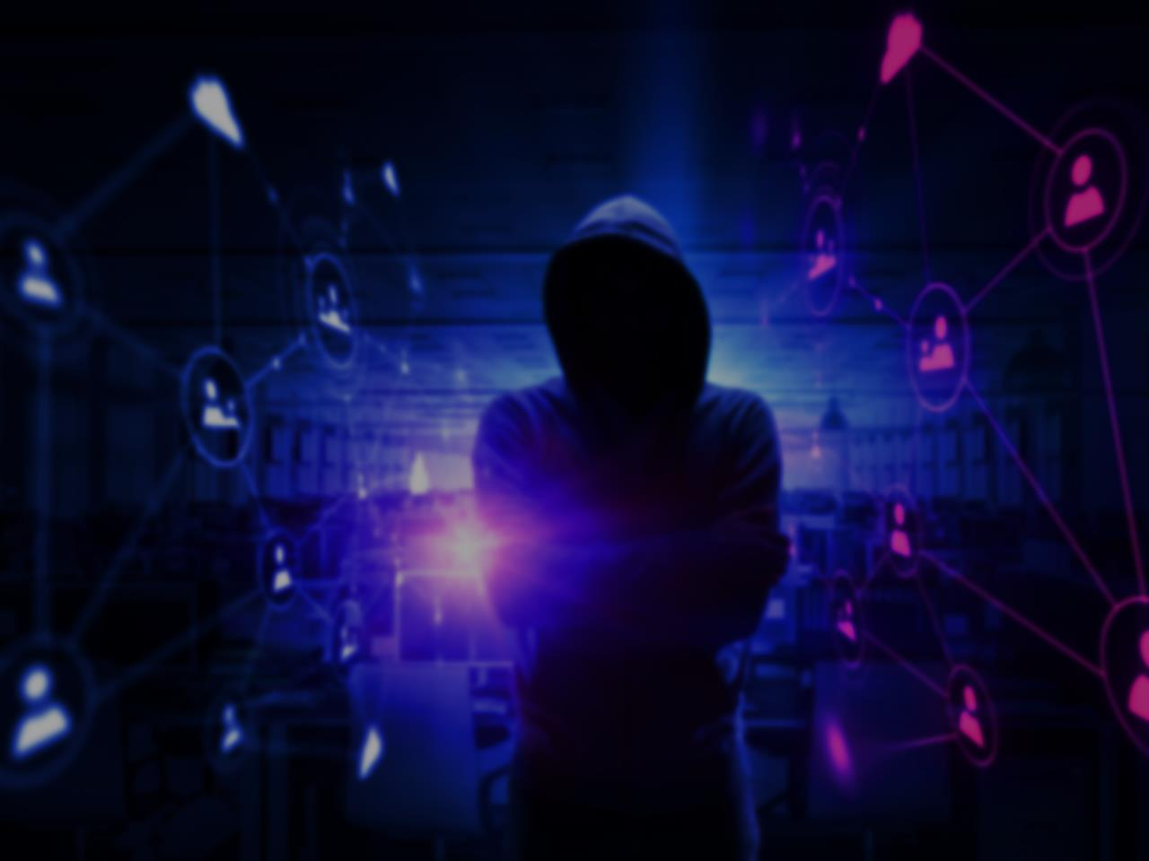
The MGM Hack :Unraveling the Chaos Behind the Cyber Attack

Slide 2
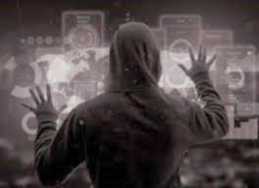
Outline
Introduction
Background of MGM hack
Methodology and techniques used
Consequences of the MGM hack
Prevention and response
Conclusion and key Takeaways

Slide 3
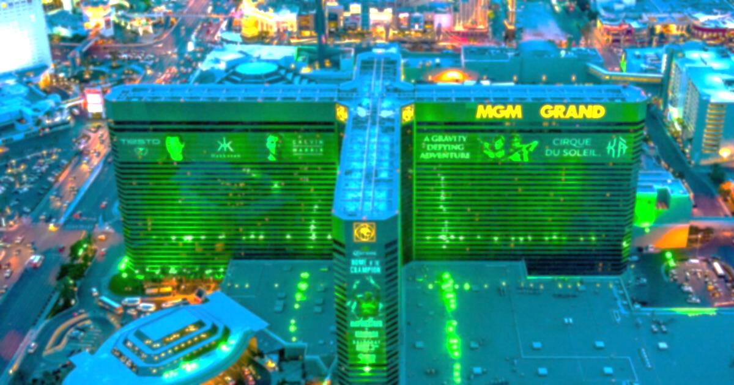
Introduction
A Cyber security issue led to the shutdown of some casino and hotel computer systems at MGM Resorts International properties across the U.S on Sep 11,2023.
In 2019 and 2014as well, MGM Resorts suffered a data breach that exposed the personal information of over 10 million guests. The incident was caused by unauthorized access to a cloud server containing guest data. The breach highlights the importance of cybersecurity and the need for companies to prioritize data protection.

Slide 4
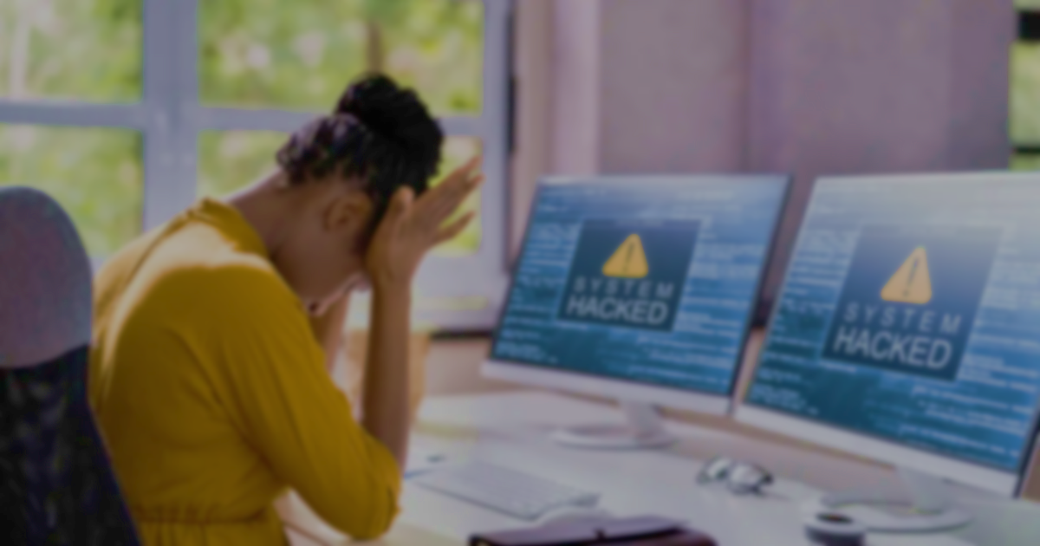
Background of MGM Hack
Hackers gained access to the personal information of approximately 50,000 customers, including names, email addresses, Phone numbers, Physical Addresses, and Birth Dates.

Slide 5
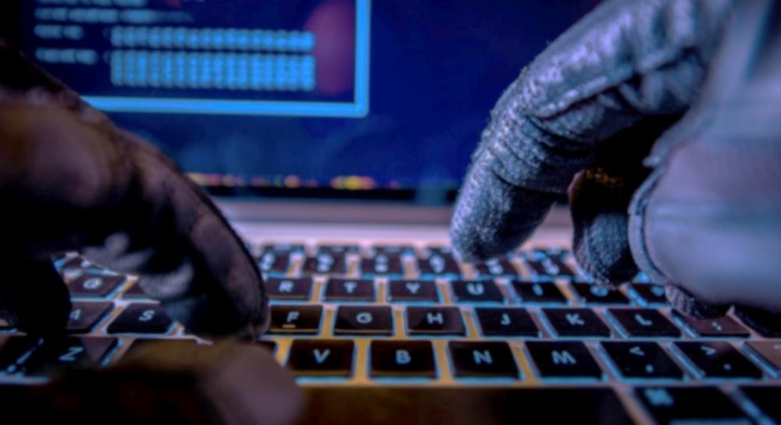
Methodology And Techniques Used
The methodology and techniques used in the MGM Hack are not fully known, but it is believed that the hackers exploited a vulnerability in the MGM's website.
Affected systems are Email Servers and Employee Personal data.
The incident affected some of the company's online systems, including its website, payment processing systems, and digital room keys

Slide 6
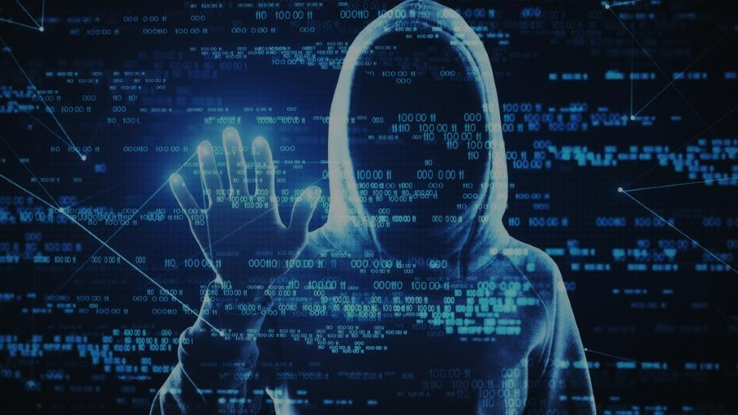
Consequences of the MGM Hack
Financial Losses: The MGM Hack resulted in significant financial losses for the company. The attackers were able to steal sensitive customer data, including credit card information, which was then used to make unauthorized purchases. This led to a loss of revenue for MGM, as well as potential legal liabilities and damage to the company's reputation.
Legal and Regulatory Implications: The MGM Hack also had legal and regulatory implications for the company. The company was required to notify the Federal Trade Commission (FTC) and other relevant authorities about the cyber attack, as well as to provide information to affected customers about the steps the company was taking to protect their personal information and prevent future.

Slide 7
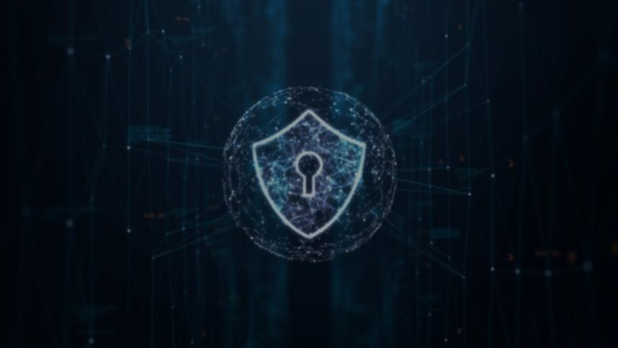
Prevention and response
Prevent cyber attacks by using strong passwords, keeping software updated, and using anti virus software. Have a response plan in case of an attack.
The MGM hack has serves as a stark reminder of the importance of investing in comprehensive cybersecurity measures to protect sensitive information and prevent future attacks.

Slide 8

Conclusion and key Takeaways
Protect your digital assets by using strong passwords multi-factor authentication, and encryption, regularly update your software and back your data.

Slide 9
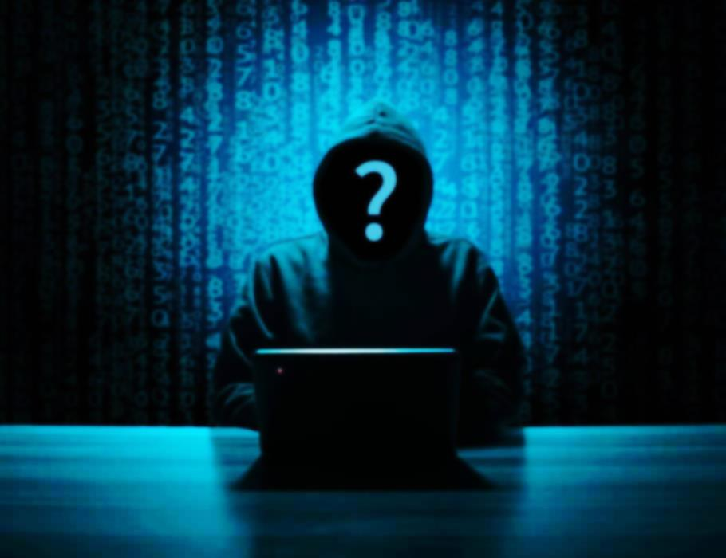
Let Me Know If You Have Any Questions

